Slide 1



Quad Chart Template
Please download and edit this to create your Quad Chart!
Once you have created your Quad Chart, delete this slide(1) and the samples (slides 3, 4, and 5). Then save your project!

Slide 2



Project Title
Author, Grade
Q1: Scientific Question
Bullet Points
Q3: Data Analysis & Results
Bullet Points
Image from project
Data Charts
Q2: Methodology or Project Design
Bullet Points
Q4: Interpretation & Conclusions
Bullet Points
Image from project

Slide 3
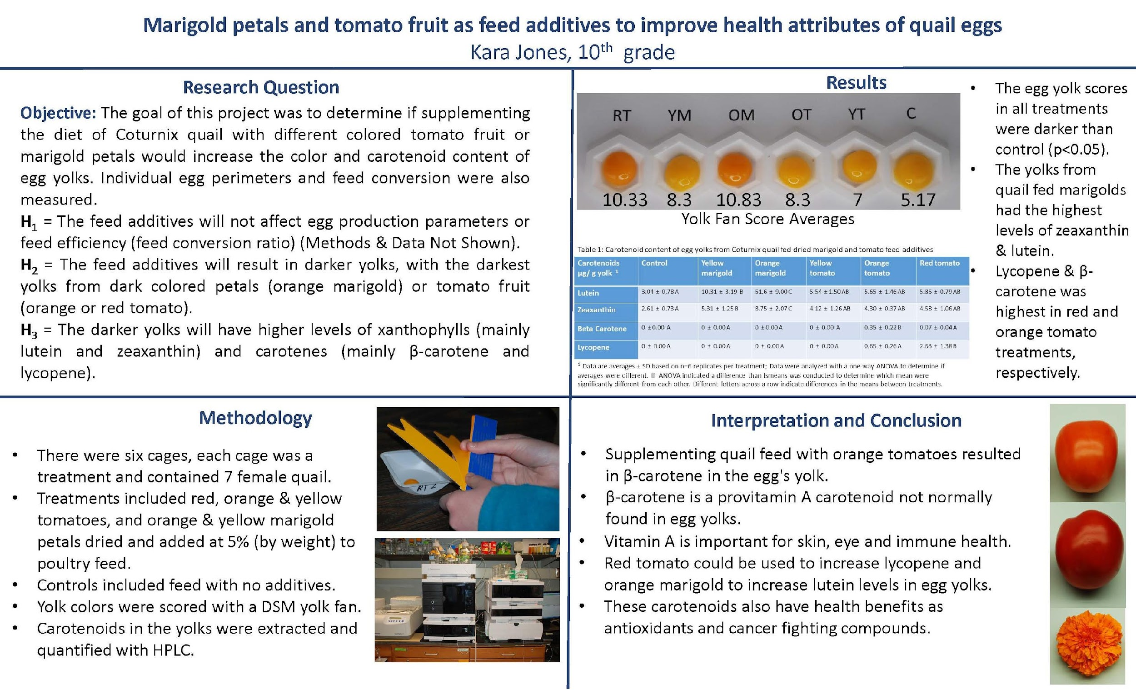
Sample 1

Slide 4
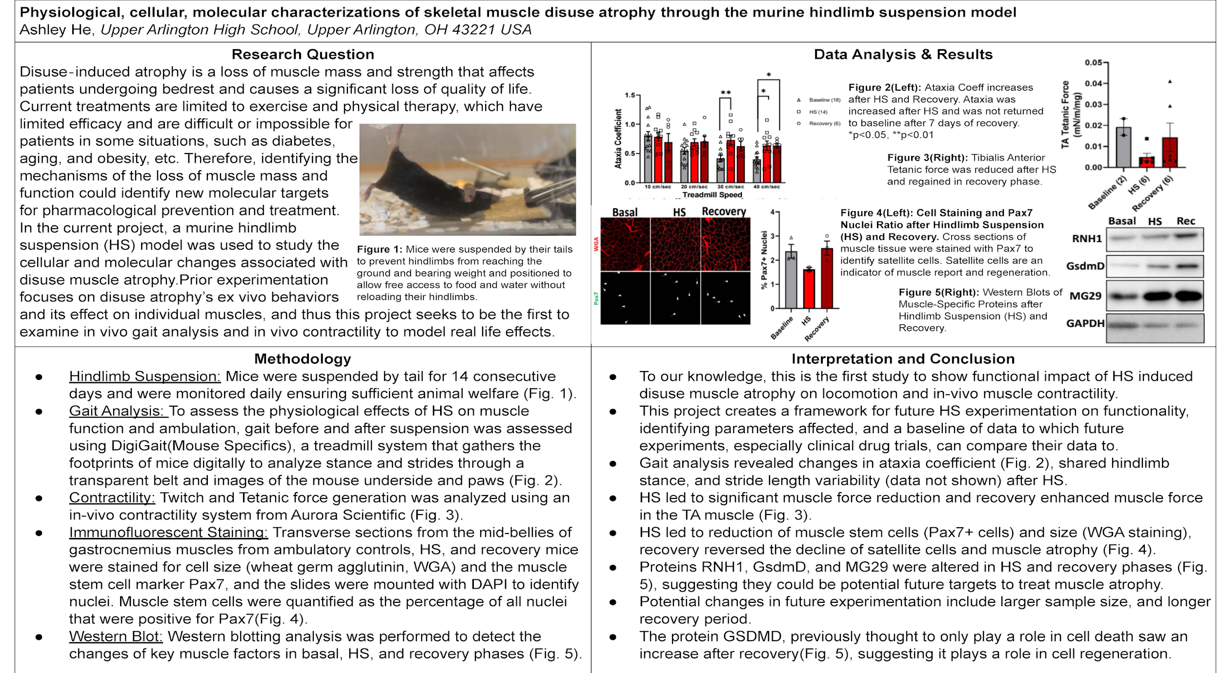
Sample 2

Slide 5

Sample 3

