Slide 1



Science Day!

Slide 2
Why Participate?
Increased student interest and understanding of science – Science Day allows students to do more than just read about science and engineering, they get to actually do science and/or engineering design!
Career Exploration – Many reports have shown that the highest paying jobs are science & engineering jobs. STEM employers are continually seeking individuals with research experience. The Science Day Program helps our students explore the possibility of working in a science related field while increasing their scientific and/or engineering knowledge and understanding.
Scholarships/Awards for students – Hundreds of thousands of dollars of scholarships and awards are given out each year to Ohio’s State Science Day participants. Additional awards may be earned at Local and Regional Science Days.
Putting academics first/student recognition - Science Days give long overdue recognition to our students for their many academic achievements.
https://www.youtube.com/playlist?list=PLmjt5bvRpXY-mqPfuyGt0EjYNNUOR6SuL

Slide 3
What Do You Find Interesting?
Branches of Science:
Life Science
  Plants
  Animals
  Bacteria
  Fungi
Earth Science
  Water
  Air
  Rocks
  Soil
Space Science
  Planets
  Stars
  Solar systems
Physical Science
  Physics
  Chemistry

Slide 4
Science Project Topics to Avoid | Why
Any topic that boils down to a simple preference or taste comparison. For example, "Which tastes better: Coke or Pepsi?" | Such experiments do not involve the kinds of numerical measurements you want in a science fair project. They are more of a survey than an experiment.
Most consumer product testing of the "Which is best?" type. This includes comparisons of popcorn, bubblegum, makeup, detergents, cleaning products, and paper towels. | These projects only have scientific validity if the investigator fully understands the science behind why the product works and applies that understanding to the experiment. While many consumer products are easy to use, the science behind them is often at the level of a graduate student in college.
Any topic that requires people to recall things they did in the past. | The data tends to be unreliable.
Effect of colored light on plants. | Several people do this project at almost every science fair. You can be more creative!
Effect of music or talking on plants. | Difficult to measure.
Effect of running, music, video games, or almost anything on blood pressure. | The result is either obvious (the heart beats faster when you run) or difficult to measure with proper controls (the effect of music).
Effect of color on memory, emotion, mood, taste, strength, etcetera. | Highly subjective and difficult to measure.
Any topic that requires measurements that will be extremely difficult to make or repeat, given your equipment. | Without measurement, you cannot do science.
Graphology or handwriting analysis. | Questionable scientific validity.
Astrology or ESP. | No scientific validity.
Any topic that requires dangerous, hard-to-find, expensive, or illegal materials. | Violates the rules of virtually any science fair.
Any topic that requires drugging, pain, or injury to a live vertebrate animal. | Violates the rules of virtually any science fair.
Any topic that creates unacceptable risk (physical or psychological) to a human subject. | Violates the rules of virtually any science fair.
Any topic that involves collection of tissue samples from living humans or vertebrate animals. | Violates the rules of virtually any science fair.
Taken from: https://www.sciencebuddies.org/science-fair-projects/science-fair/science-fair-project-question#examples

Slide 5
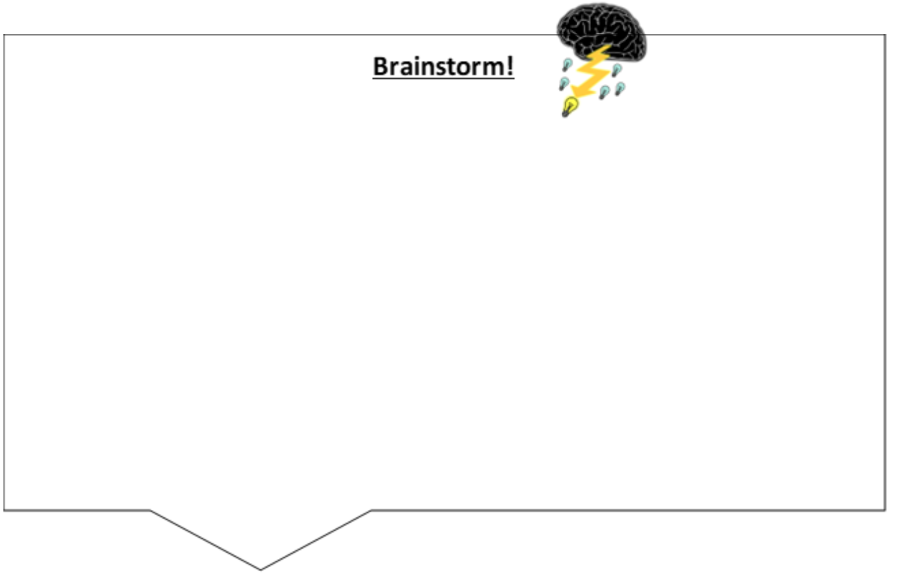
What Interests You?!
Hypothesis Based Research Part I:
Brainstorm
Brainstorm ideas, things you wonder about, observations you have made,
or activities that spark your curiosity and capture your interest.
Engineering Design Part I:
Brainstorm Problems
Think about things that “bug” you - problems with a process or product.

Slide 6

Choose!
Circle the three you like the BEST!
Underline the choice that interests you the most! This is your topic to research or problem to solve!
If you are solving a problem, write your problem statement:
How might we help __________________find a better way to (name of person you’re helping)
_________________ because/in order to ______________________? (actionable need person has) (a surprising insight or takeaway)

Slide 7
Still Need a Topic?
Check out these resources for ideas!
Grow Next Gen
https://grownextgen.org/sciencefair
Science Buddies
https://www.sciencebuddies.org/
Science Bob
https://sciencebob.com/wp-content/uploads/2015/03/Science-Fair-Ideas.pdf
Ohio Heartland Science
http://www.heartlandscience.org/
NASA Science
http://science.nasa.gov/
Ohio Oil & Gas Energy Education Program
http://www.oogeep.org/teachers-students/science-fair/

Slide 8
Approval
Turn your worksheet into your teacher for approval!

Slide 9
AI Platforms
Chat GPT: https://chatgpt.com/
SciSpace: https://scispace.com/
Google Gemini: https://gemini.google.com/
Microsoft CoPilot: https://copilot.microsoft.com/
Important Reminder When Using AI:
Always ask for references in your prompt if you need sourced information. Then, take the time to visit each site to confirm the links are valid and the sources are credible.
Remember, AI can sometimes generate false or misleading information—a phenomenon known as hallucination. To minimize this risk, carefully verify all references and rely only on information that comes from legitimate, trustworthy sources.

Slide 10
Phenomena
Phenomena - The "what" of science, the observable things we study to understand the "how" and "why".
Engineering involves designing solutions to problems that arise from phenomena and using explanations of phenomena to design solutions.

Slide 11

Research
Part II: Research Concepts Related to Phenomena
Research science phenomena related to your problem.
Hypothesis Based Research Engineering Design
Write down ONE phenomenon related to your problem that you wish to further explore. You may explore multiple phenomena if you choose (use a separate worksheet for each phenomenon).
Chat GPT Prompt:
Science phenomena and concepts and your topic
Chat GPT Prompt:
Science phenomena and concepts for your problem

Slide 12
Research
List science concepts related to the phenomenon you chose and list them in the table below.
Concepts (the science explaining the phenomenon)

Slide 13
Research
Hypothesis Based Research:
Generate questions you have about your phenomena and related concepts.
Engineering Design:​
Generate questions you have about how your concepts can be used to better frame the problem you are trying to solve.
Questions (include why & how)

Slide 14
Research
Hypothesis Based Research:
Determine if your questions are open or closed ended. (Closed ended questions can be answered with yes or no.)
Look at your open-ended questions and determine if they are testable. (Testable means data can be collected.)
Put a star next to ONE testable question you wish to further explore!
Engineering Design:
Conduct research to see what solutions already exist. List them below.
Solution 1:________________________________________________
Solution 2:________________________________________________
Solution 3:________________________________________________

Slide 15
Research
Hypothesis Based Research:
Now you should have at least ONE testable question you can use for your project!
Engineering Design:​
After identifying solutions that already exist, look at your questions again. Modify one to make it slightly different than existing solutions OR use a question that has no solution!
This will be your problem to solve!

Slide 16
Still Don't Have a Topic or Problem?
Explore these resources!
Nasa – How to do a Science Fair Project
https://www.jpl.nasa.gov/edu/learn/activities/science-fair-project/?utm_source=pbohiosci_resources&utm_medium=web&utm_source=pbohiosci_resources&utm_medium=web
Grow Next Gen
https://grownextgen.org/sciencefair
Ohio Soybean Council
https://www.soyohio.org/council/science-fair/
Science Buddies
https://www.sciencebuddies.org/
Science Bob
https://sciencebob.com/wp-content/uploads/2015/03/Science-Fair-Ideas.pdf
Ohio Heartland Science
http://www.heartlandscience.org/
NASA Science
http://science.nasa.gov/
Ohio Oil & Gas Energy Education Program – Project Ideas
http://www.oogeep.org/teachers-students/science-fair/
Geological Society of America – Education & Resources
http://www.geosociety.org

Slide 17
Approval
Turn your worksheet into your teacher for approval!

Slide 18
Research – The Deep Dive!
Next, you are going to conduct research over your question or problem and related concepts.
You can start by using the AI website SciSpace or utilize the list of research resources on the next slide.
SciSpace: https://scispace.com/
Feel free to find other AI research sites!

Slide 19
Research Resources
INFOhio: https://www.infohio.org/
Journal of High School Science: https://jhss.scholasticahq.com/
Science Journal for Kids: https://www.sciencejournalforkids.org/
The Scientific Teen: https://www.thescientificteen.org/
Young Scientists Journal: https://ysjournal.com/
Science News for Students: https://www.snexplores.org/
Google Scholar: https://scholar.google.com/
Science Direct: http://www.sciencedirect.com/science/search
National Library of Medicine: www.ncbi.nlm.nih.gov/pubmed
Category: Life Sciences
IEEE Xplore: ieeexplore.ieee.org/Xplore/guesthome.jsp
Categories: Electronics, computer engineering, computer science
Agricola: Agricola.nal.usda.gov
Category: Agriculture
ERIC Institute of Education Sciences: Eric.ed.gov
Category: Education
Nasa: https://www.sti.nasa.gov/
Category: Aerospace
Harvard Astrophysics Data System: adswww.harvard.edu/
Categories: Astronomy and Physics
Cornell University: arxiv.org/
Categories: Physics, Mathematics, Computer Science, Biology
CiteSeerX: citeseerx.ist.psu.edu/
Category: Computer Science
PLOS: https://www.plos.org/
Category: Life Science
BioMed Central: www.biomedcentral.com
Category: Biology and Medicine
DOAJ: http://doaj.org
eLife: http://elifesciences.org
Category: Life Science

Slide 20
How to take notes when conducting research?
Use a note taking template: https://llc.wrdsb.ca/learning/research-process/note-taking/note-taking-templates/
Include the following:
Type: Book, Journal Article, etc.
Citation
Title
  Direct quotes you wish to use
  Statistics and figures
  New terms
  Summary of findings—summarize findings in your own words.

Slide 21
Think about the following as you conduct your research
Can the author’s experiment/design be reproduced? ​
Think critically and logically about relationships between the evidence given and the explanation provided. Does the explanation make sense? Did the author leave out any important information?​
Could there be another way to interpret and explain the results of the research?​
Did the author clearly communicate the science?​
Was the author being ethical in their reporting?​
What are the implications of this research?

Slide 22
How to Cite Sources
References Use APA-style formatting for your reference list and in-text citations.
List your references in alphabetical order using APA-formatting (double space in between references; hanging indent, etc.)
Resource for 7th Edition APA–https://apastyle.apa.org/instructional-aids/reference-examples.pdf
Citation generator:
https://owl.purdue.edu/owl/research_and_citation/apa_style/apa_formatting_and_style_guide/general_format.html
GenAI Sources: Must be adequately explained and cited - https://apastyle.apa.org/blog/how-to-cite-chatgpt

Slide 23
NEXT STEP
Continue your Research then Move on to your RESEARCH PLAN!

