Slide 1

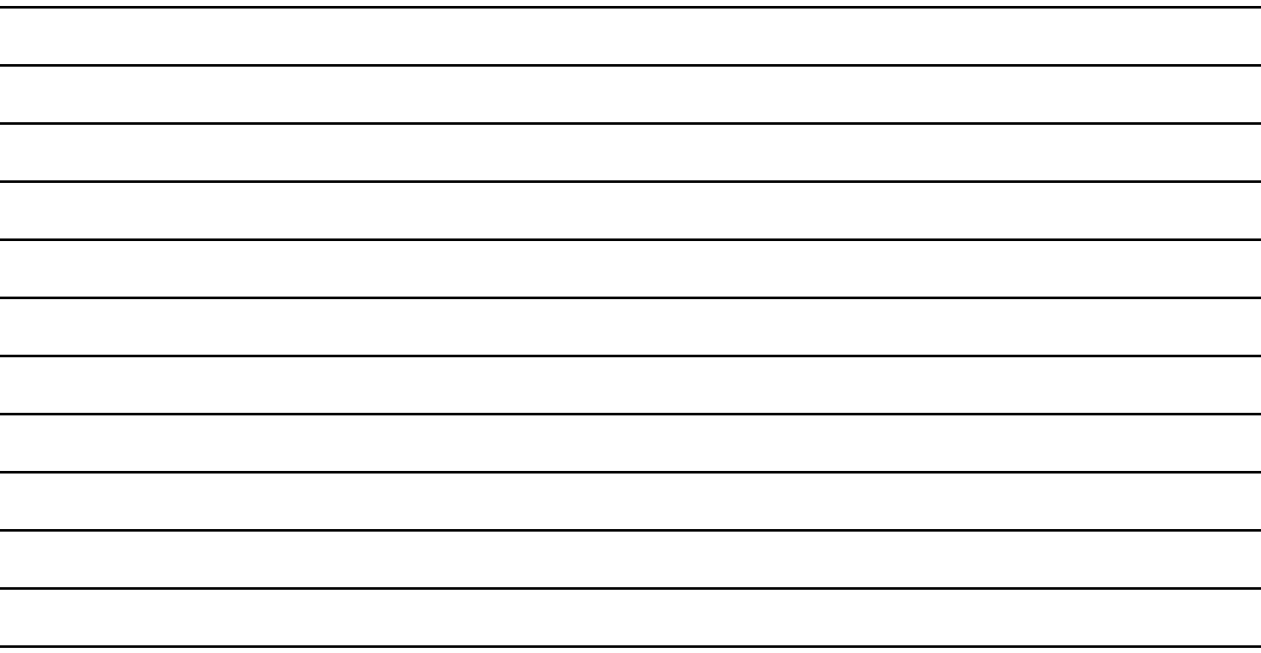
Ohio STEP Judging Card
Summary Plan and Pitch
Plan Title:___________________________________________________________________________
Student Name(s):_____________________________________________________________________
Judge’s Printed Name:_________________________________________________________________
Signature:___________________________________________________________________________
Total Points:
______/ 80
JUDGES MUST ADD COMMENTS: Students look for constructive feedback to improve their project for the future! Continue on the back if needed!
Summary Plan Points:
Total Summary Plan
Points:
____/ 40
Problem/Solution
_____/10
STEM Research
_____/10
Commercialization
_____/10
Communication
_____/10
Pitch Points:
Problem/Solution
_____/10
Value
Proposition
_____/10
Communication
_____/10
Time
_____/10
Total Pitch
Points:
_____/ 40
Copyright © 2025 by The Ohio Academy of Science. All rights reserved. No edits or other modifications may be made in the judging criteria without the express written permission of The Ohio Academy of Science. Distribution and reproduction for educational purposes permitted if this notice is not removed.

Slide 2
Ohio STEP Judging Card —Summary Plan
Scoring Guidelines: Unless otherwise listed for criteria.
Meets ALL–Includes all required elements. Provides many details.
Meets SOME–Includes all or most of the required elements. Provides some details.
Meets FEW–Includes some of the required elements. Provides some or no details.
**Bullets do not have a pre-determined numerical value.**
Meets ALL
8-10 Points
Meets SOME
4-7 Points
Meets FEW
1-3 Points
PROBLEM/ SOLUTION – Required Elements
Identifies the problem.
Describes why the problem exists based on evidence from research.
Identifies the target customer/intended user.
Quantifies the magnitude of the problem.
Provides a novel/innovative solution.
Problem/Solution
Points:
_____/10
Explains WHY the chosen STEM concepts are important to the solution.
Explains HOW the STEM concepts are used in developing the solution.
Describes the design of the prototype.
Explains how the prototype functions (product or app only).
Includes a labeled drawing of the prototype (product or app only).
Lists the step-by-step process needed to construct a physical prototype.
Includes an optional working or non-working physical prototype.
Lists the process for how the service will operate based on the greatest customer need (service only).
STEM RESEARCH – Required Elements
STEM Research
Points:
_____/10
COMMERCIALIZATION - Required Elements
Describes competitors and how the solution is different (design, functionality, performance, or customization).
Discusses the benefits the solution provides over the competition (e.g., cost-effectiveness, ease of use, faster, durable, recyclable, convenience, etc.).
Provides an analysis of expected revenue streams and start-up and operating costs.
Commercialization
Points:
_____/10

Slide 3
COMMUNICATION – Required Elements
Includes a well written Elevator Pitch with the following elements: the problem, users, magnitude of problem, solution, how STEM research provides support/evidence of effective solution, and value proposition.
Communication is concise, understandable, and compelling.
Exhibits exceptional organization and writing including logic of data analyses and arguments, appropriate graphics, grammar, spelling, and professional appearance.
Includes proper labels, captions, attributions, and legends for all figures and photos.
Uses in-text citations; includes AI-generated references and AI Prompt and Response Log.
Provides a reference list from a variety of scholarly sources.
Communication
Points:
_____/10
CONTINUE JUDGING: PITCH BELOW

Slide 4
Ohio STEP Judging Card — Summary Pitch
Scoring Guidelines: Unless otherwise listed for criteria.
Meets ALL–Includes all required elements. Provides many details.
Meets SOME–Includes all or most of the required elements. Provides some details.
Meets FEW–Includes some of the required elements. Provides some or no details.
**Bullets do not have a pre-determined numerical value.**
Meets ALL
8-10 Points
Meets SOME
4-7 Points
Meets FEW
1-3 Points
PROBLEM/ SOLUTION – Required Elements
Identifies a problem.
Identifies intended users.
Quantifies the magnitude of the problem.
Identifies an innovative solution and its function.
Describes the evidence (from STEM research) that supports the solution.
Problem/Solution
Points:
_____/10
VALUE PROPOSITION – Required Elements
Identifies the competition.
Discusses how the solution is different from the competition (more cost effective, faster, durable, reliable or convenient).
Discusses what benefits the solution provides over the competition.
Explains how the product or service solves a problem for the user.
Value Proposition
Points:
_____/10
COMMUNICATION – Required Elements
Communication
Points:
_____/10
Communication is clear, concise, and easy to understand.
Provides a “Hook” that is engaging and original.
All students on project are visible in video and participate in presentation.
Convincing to prospective investors.
TIME – Required Elements
Scoring Guidelines:
Meets ALL –1 ½ - 2 minutes
Meets SOME –1-1 ½ minutes
Meets FEW –Less than 1 minute or exceeds 2 minutes
Time
Points:
_____/10
  Video Length
Your pitch video should be no longer than 2 minutes.

