Slide 1
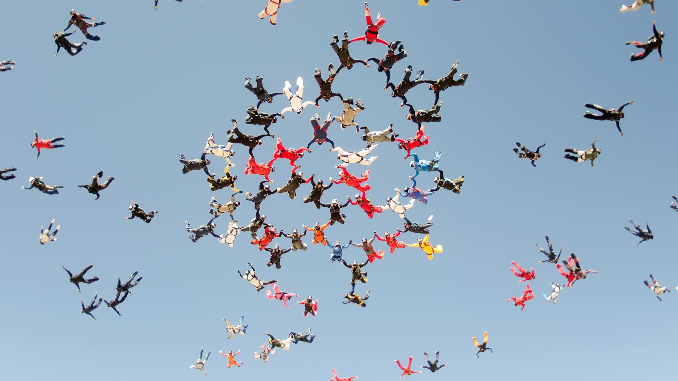




Ideation & Pitch
Intro to Design Thinking
Ohio STEP (Science, Technology, and Entrepreneurship Program)
Heather Braun, PhD
Notes:
Welcome back. Before we begin to ideate for the problem that you selected from your empathy interview, let’s take a minute to think about our experiences with brainstorming up until this point.

Slide 2
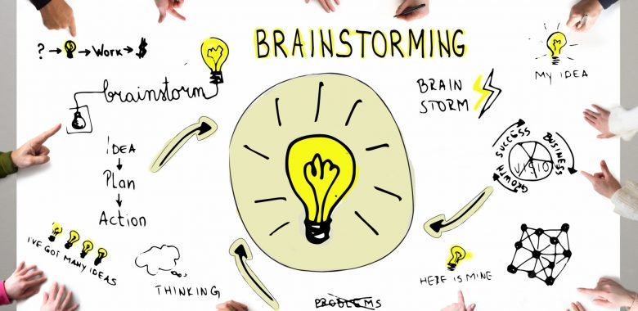
Notes:
(Slide 2) Before today, what have your brainstorming sessions looked and felt like? If you’re on the quieter side, maybe you don’t get the chance to share ideas. Or, if you share an idea, maybe it was ignored or replaced with someone else’s. Before we start today, think about what worked and didn’t work during these brainstorming sessions.

Slide 3


Notes:
(Slide 3) The main goal of our brainstorming session today is not to make a wall of used Post-It notes. Our goal is to extract new information from doing this activity together. For ideation to be most effective, we must first silence our own inner critic, the one that tells us not to share ideas that may seem off the wall. Then, we have to listen actively and remove our egos as we did when we completed our empathy interview. It might be helpful to think about this as a sharing of many ideas as possible without trying to own or get attached to a single one.

Slide 4

Rules for Brainstorming
Defer judgment.
One idea at a time.
Go for volume.
Build on the ideas of others.
  Encourage wild ideas.
Notes:
(Slide 4) To get as many ideas out there as we can, we are going to follow these basic rules of brainstorming:
Defer judgment. For ideation to be most effective, you must defer judgment. When people in the group feel criticized, they aren’t likely to give their best ideas.
One idea at a time. Otherwise, some ideas just won’t get heard or recorded
Similarly, you want to go for volume. In study after study, it turns out that having lots of ideas gives you more ideas to choose from. It doesn't matter if they're good ones or bad ones. The more you have the more you have a chance of coming up with something truly innovative.
Hence, you want to build off the ideas of others using the improv technique - yes, and.... What somebody has said, you say yes and then you build it and you take it to the next step.
Finally, try to encourage wild ideas and new ways of thinking. This is how we move beyond familiar and traditional ways of thinking. And the purpose of brainstorming is to help uncover fresh ideas.

Slide 5






WHY WILD IDEAS ?!
That won’t work!!
WILD IDEAS
HIDDEN IDEAS
SOLID IDEAS
To get your best ideas you want access to all your ideas!
Notes:
(Slide 5) Encouraging wild ideas is one way to do this because it helps to free lots of good ideas that might otherwise be contained. This helps your team move far beyond the ideas that you had when you first started in order to get past the obvious and into the innovative and weird and interesting, which is where I hope we can get to today.

Slide 6
STEPS OF IDEATION
1.
FRAME a good problem
WARM UP
BRAINSTORM lots of ideas
SELECT ideas based on a specific criteria
EXTRACT INSIGHTS for Pitch
2.
3.
4.
5.
Notes:
(Slide 6) Before we begin, let’s just go over the basic process of Brainstorming. Today, we’ll follow 4 basic steps, one of which you have already done!
•First, you need to frame a good problem before brainstorming to solve it. This ensures you’re actually brainstorming to solve the right problem. You already did this when you created your “How might we” questions in the last session. You’ll use these today for our brainstorm session.
•Then, you need to warm up, to get yourself into a space where you can let go and create without judgment or other barriers.
•Next, we’re going to generate lots and lots of ideas.
Then, we’ll select from our ideas based on specific criteria such as the most delightful or craziest one.
Finally, we’ll extract insights from those ideas to create a short pitch for the larger group.

Slide 7

Warm Up!
Notes:
Teacher-Led Activity
Materials: A large piece of paper, pens, and post-it notes or a large white board (miro.com).
In the same groups you formed for your empathy interviews, you are going to warm up for our brainstorming session, which will be planning a party together.

Slide 8


Rules for Brainstorming
Defer judgment.
One idea at a time.
Go for volume.
Build on the ideas of others.
Encourage wild ideas (Yes, And…!)
Notes:
(Slide 8) As a you plan your party in small groups, remember the rules of Brainstorming: defer judgment, go for volume, build off the ideas of others, and encourage wild ideas, you're going to get a huge selection of really interesting ideas that we then down select from in the choosing process.
First you need to pick a reason for this party - will this be a graduation party, a goodbye party to coronavirus? What do you want to celebrate? You decide, but there are no rules/no budget.
The only rule is you’ll need to work together to embrace all ideas with ridiculous optimism. Instead of asking questions or expressing doubts, everyone will respond supportively with YES!...And….building upon each person’s idea.
After 3 minutes, debrief for a minute about ideas you had. How would this session have been different had someone in your group responded “Yes - BUT…” instead of “Yes, And...”?

Slide 9
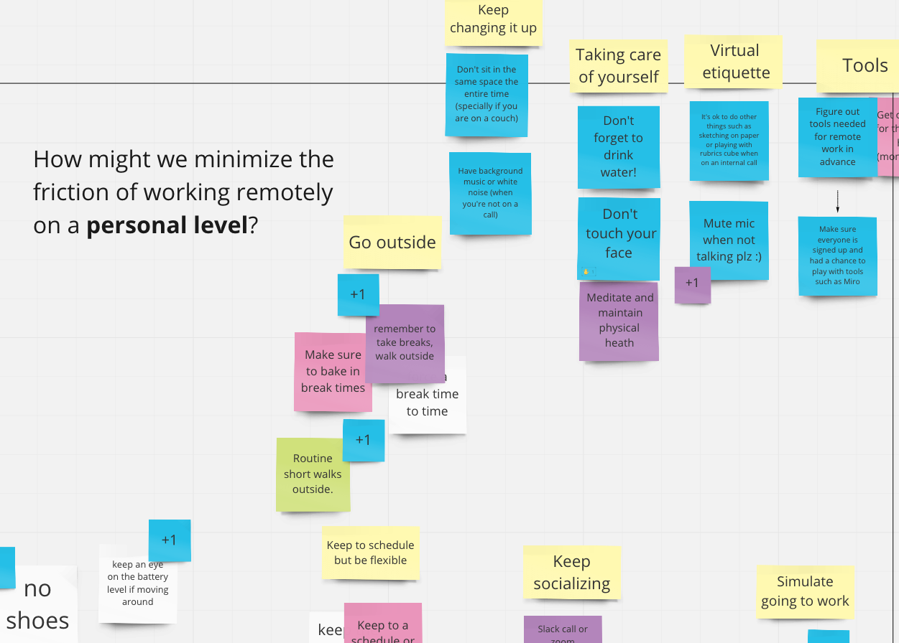
IDEATION SESSION
Instructions
Return to teams of 4
Write Problem Statement at Top
One idea per Post-It
Arrange Post-Its under themes or “headline” ideas
Go Fast, but one at a time!
Notes:
Materials: A large piece of paper, pens, and post-it notes or a large white board (miro.com). In this same spirit, let’s try this exercise with the problem statements you created from the Empathy interviews.
Return to groups of 4
Begin by writing your problem statement at the top of your paper or Miro board.
Circle or underline this HMW question
Collect as many ideas as possible related to this question.

Slide 10


IDEATION: ROUND 1
BRAINSTORM FOR 3 MINUTES (record one idea at a time): How Might We…
B. SELECT AN IDEA BASED ON SPECIFIC CRITERIA AND EXTRACT INSIGHTS
Vote for the WILDEST idea
Each person gets two votes
Notes:
(Slide 10)
Keeping in mind the rules of brainstorming, let’s begin Round 1
Start Timer (play music for timing) - STOP after 3 minutes
Count ideas
Quickly debrief on what's working/not working
Now it’s time to vote: with dots or check marks next to post-its, VOTE for top 2 Wildest Ideas

Slide 11
IDEATION: ROUND 2
BRAINSTORM FOR 3 MINUTES (record one idea at a time)
SELECT AN IDEA BASED ON SPECIFIC CRITERIA AND EXTRACT INSIGHTS
Vote for the WILDEST idea
Each person gets two votes
Notes:
Keeping in mind the rules of brainstorming, let’s begin Round 2
Start Timer (play music for timing) - STOP after 3 minutes
Count ideas
Quickly debrief on what's working/not working
Now it’s time to vote: with dots or check marks next to post-its, VOTE for top 2 Most Promising Ideas

Slide 12
IDEATION: SELECTION
SELECT AN IDEA BASED ON SPECIFIC CRITERIA AND EXTRACT INSIGHTS
Your group chooses an unusual criterion to assess/sort your ideas
MOST DELIGHTFUL
WILDEST
MOST INTRIGUING
GREATEST PROMISE OF LONG-TERM IMPACT
Don’t select an idea because of its feasibility (yet)
Notes:
(Slide 12) Return to your Round 1 Brainstorm:
Examine your Wildest Idea (2 min)
Discuss & identify what insight(s) are to be found in that wild idea.
What next steps could be taken to follow up on that insight?
Ask for better, feasible idea, pen an area for further research (empathy), or redefine your problem or goal (reframe)
Now, return to your Round 2 Brainstorm (2 min)
Examine the Idea with the Most Promise
Discuss & identify what insight(s) are to be found in this most promising idea.
What next steps could be taken to follow up on that insight?
Ask for better, feasible idea, pen an area for further research (empathy), or redefine your problem or goal (reframe)

Slide 13

IDENTIFY IDEA WITH MOST VOTES
Criteria for Selection
How excited is your team about this idea?
How innovative is this idea from other ideas?
How practical is this idea to implement?
Notes:
(Slide 13) Total Up your votes: as a group, decide which one will you Pitch. How excited is your team about this idea? How innovative is it? And how practical would it be to prototype. If someone would like to share one idea from their session, please share it now.

Slide 14
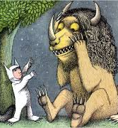
EXTRACT INSIGHTS FOR PITCH
Choose Idea for your Final Pitch
Discuss & identify what insight(s) are to be found in this idea? What excites you about it.
What next steps could be taken to follow up on that insight?
  get some better, feasible ideas
  open an area for further research (empathy)
  redefine your problem or goal (reframe)
Notes:
(Slide 14) Next, we’ll use these insights to create something for this person to help them. This idea will be what you pitch with your group. What excites you about this idea? What makes it innovative and practical? What next steps could be taken to follow up on that insight? get some better, feasible ideas? open an area for further research (empathy)? or , redefine your problem or goal (reframe)

Slide 15


TAKEAWAYS
Generating ideas is a skill.
Practice helps.
Key Outcome: to get new & actionable insights
To design your best and most interesting idea, you want all your ideas.
You need some wild ideas to get to the really innovative ones” - David Kelley
Notes:
(Slide 15) Before we move to your Pitch, let’s share some takeaways from our brainstorm session with the larger group. Here are some examples: generating ideas is a skill, practice helps, the key is to get new and actionable insights, and to design your best idea, you need them all. As Kelley explains it, “you need some wild ideas to get to the really innovative ones.”

Slide 16


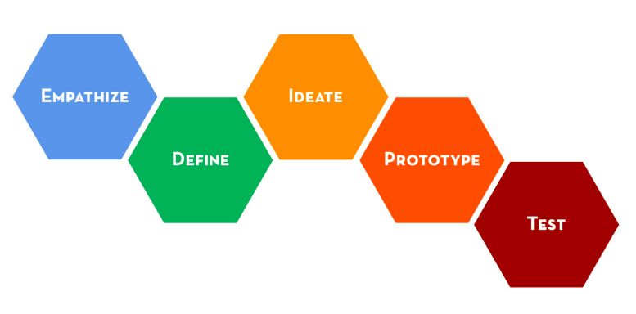

Take it further
_________
BIAS TOWARD ACTION
Notes:
(Slide 16) To finish, each group will create a short, 1-minute elevator pitch: this will be the prototype you make to share your idea with the group. It doesn’t need to be fancy. But here are some guidelines for what to include in it.

Slide 17


Formulate Your Pitch
2. Present Your Elevator Pitch
1. Write an “elevator pitch” (3 sentences max) summarizing your entire plan
How will you present your pitch
Who will deliver which parts of your pitch?
Each group will get 1-2 minutes to present
their problem/solution
Your pitch must define a problem & solution in the simplest terms possible
Your pitch should identify the needs of your target audience (whose problem does this pitch try to solve?)
Arrange your ideas in a logical manner.
Consider how you might expand this short pitch into something longer.
Notes:
Write an “elevator pitch” (3 sentences max) summarizing your entire plan
Your pitch must define a problem & solution in the simplest terms possible
Your pitch should identify the needs of your target audience (whose problem does this pitch try to solve?)
Arrange your ideas in a logical manner.
Consider how you might expand this short pitch into something longer.
Present Your Elevator Pitch
Determine which members of your group will present which parts of your pitch.
Each group will get 1 minute each to present their problem/solution

Slide 18
Closing Reflection
One Word to Describe Your Experience Today
Notes:
(Slide 18) Parting Ah-ha moment
Before we go, let’s share an Ah-ha moment from this workshop: a word or phrase to describe what you found surprising or important about the design thinking process. You can share these verbally or use the Chat function to share your takeaway.

