Slide 1
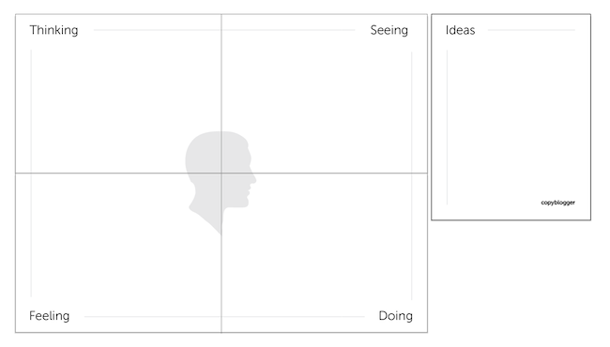

Empathy Map
Name:
_________
Video 2 Worksheet

Slide 2
Write a Problem Statement
Video 2 Worksheet
How might we help ______________________________________________
(name of person you’re helping)
find a better way to _______________________________________________
(actionable need person has)
because/in order to _____________________________________________?
(a surprising insight or takeaway)

