Slide 1

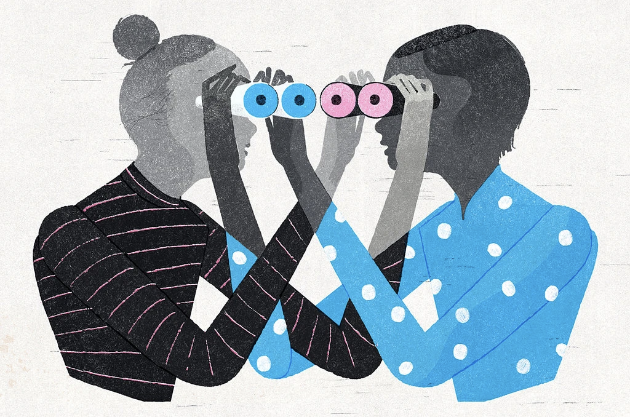

Empathize & Define
Intro to Design Thinking
Ohio STEP (Science, Technology, and Entrepreneurship Program)
Heather Braun, PhD
Notes:
What is Empathy? and why is it important to design thinking and solving for the right kind of problem?

Slide 2
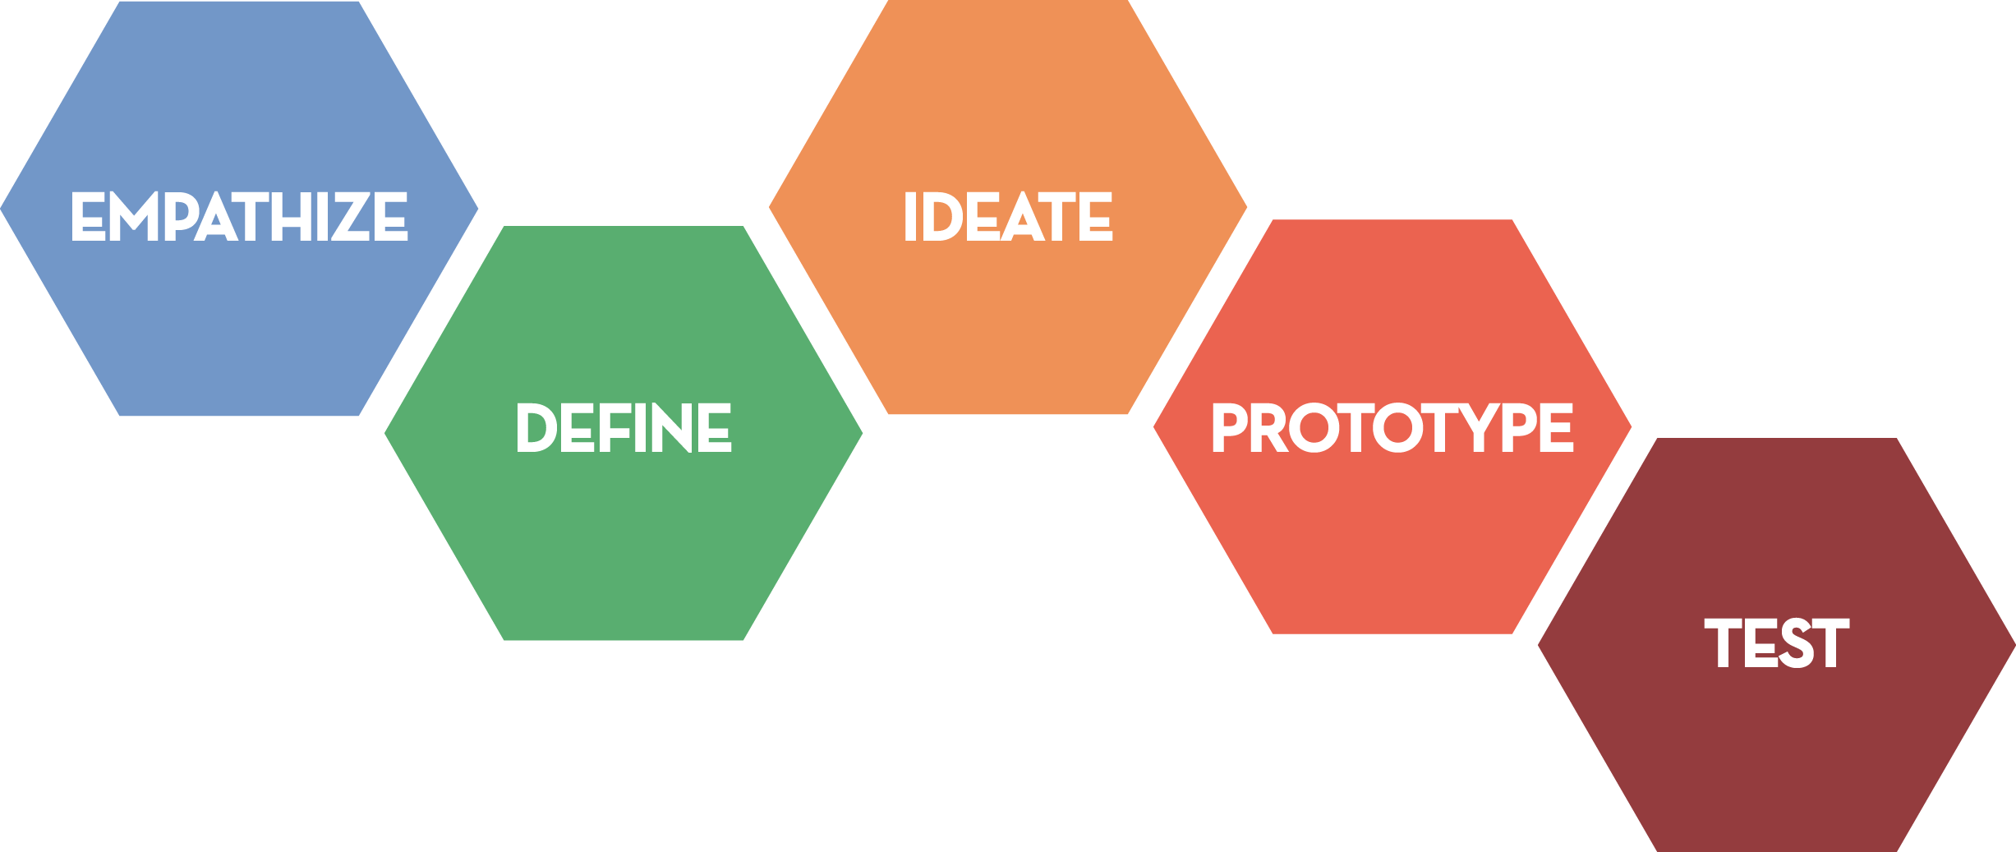
ZOOMING IN: Empathy and Define
ROLE + GOAL
Notice WHO they’re trying to empathize with, and their ROLE.
Notes:
(Slide 2) Before we can solve a problem, we first need to learn more about it from the people who experience it directly. We then use that information to reframe and define what the problem is before we begin to brainstorm for ways to solve it. It can be tempting to jump straight to solutions to a problem. But these first two steps - empathy and define - are crucial to making sure you understand what problem you’re trying to solve.

Slide 3
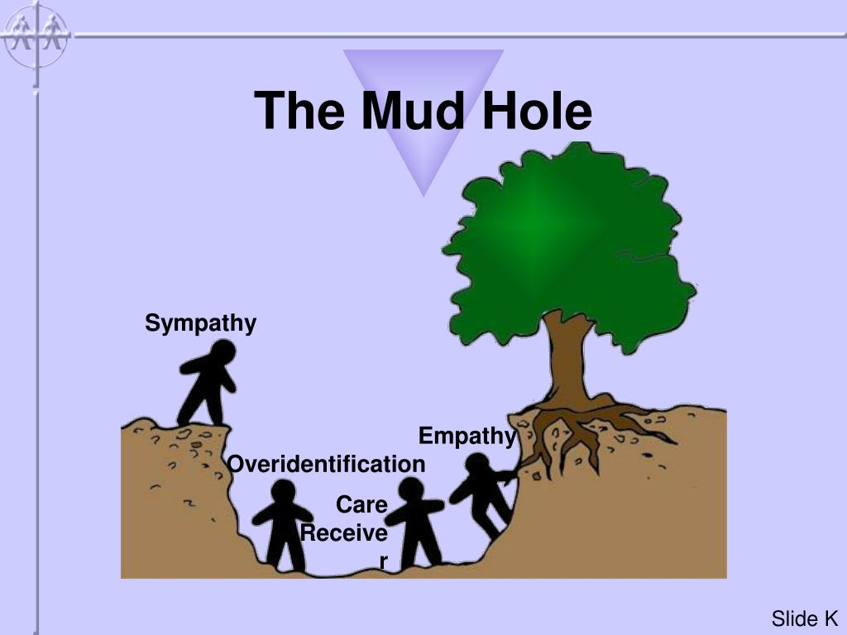
Empathy vs. Sympathy
What is the Difference?
Click Here to
Play Video
Video Credit: Brené Brown
Notes:
(Slide 3) The best way to understand Empathy is to see it as something distinct from Sympathy.
Brené Brown is an expert in the areas of empathy and vulnerability. She defines empathy as the ability to feel with someone rather than for their situation. To hear Brown’s description of what makes empathy different than simply, click here to watch a short video: https://www.youtube.com/watch?v=HznVuCVQd10&feature=youtu.be

Slide 4
How Do We Empathize?
Put aside your own ego
Encourage storytelling
Ask one open-ended question at a time
Listen more than talk
Be an Active Listener
Notes:
(Slide 4): With this definition of empathy in mind, let’s look at how we empathize in an empathy interview:
First, put aside your own ego. This gets in the way of hearing good ideas not our own
Encourage storytelling: “Say more about that" or "can you repeat that"
Ask one open-ended question at a time to avoid confusion
Listen more than you talk: this is important for your to actually observe:
What is the person doing? (observable facts)
How is the person doing that? (what emotions and techniques are present?)
Why is the person doing that? In that specific way? (what inferences or surprising insights can take away from this behavior)
Be an Active Listener
What does active listening look like?

Slide 5
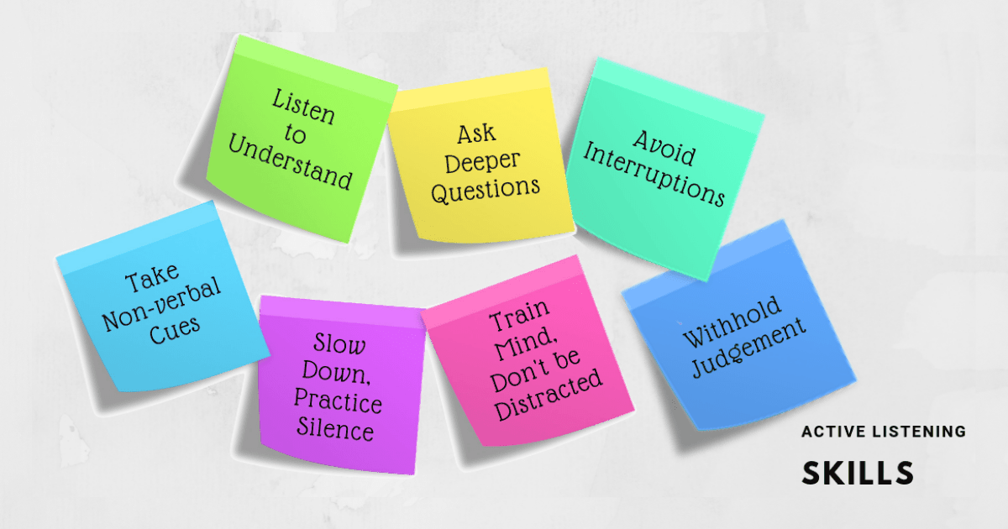
Notes:
(Slide 5) In an empathy interview, your main goal in listening to your partner is to understand their problem, need or pain point. Sometimes this means staying silent. Other times this means asking deeper questions. Your job is not to judge but to notice the various ways in which people tell stories about themselves.

Slide 6
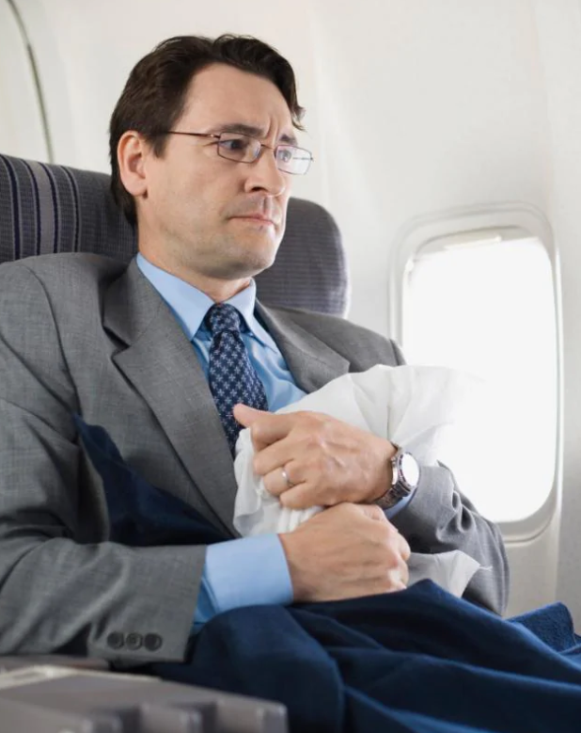
Extreme Users
“Extreme users are people who are extreme in some aspect related to your project. Because extreme users’ behaviors and feelings are amplified, they help you notice nuances and develop insights.”
*Empathy Field Guide, Stanford d. School
Notes:
(Slide 6) First, we need to determine whom we are empathizing with? The best place to start is with extreme users - these are the people most directly impacted with the problem you’re tackling. For example, an air travel design challenge might include extreme users such as a family flying with young children; someone who is scared of flying; someone needing the wheelchair services. Today, all of you are extreme users: you are all facing challenges, and you’re going to talk about one of these challenges with one other person.

Slide 7
EMPATHY INTERVIEWING
Guiding question & Purpose of Empathy Interview:
How might I design a tool to help this person directly with a
problem they currently face with a product, system or service?
Notes:
(Slide 7) Before we break into pairs, we’re going to try out these skills by doing an empathy interview with one member of your team. This is an opportunity to engage with people on a deeper level, to get personal stories that will help you identify a problem before you begin solving it. Your guiding question will be: How might I design a tool to help this person directly with a problem they’re facing using a product, service or system in their everyday lives? It may be helpful to recall the shopping cart video: in this case, one person you might want to interview is a parent about their experience putting their child in this cart.

Slide 8

EMPATHY INTERVIEWING
Get the deeper story.
Keep the focus on the speaker.
Ask broad "Why” questions.
Listen without judgment.
  Sample questions
  Tell me about a typical day for you right now.
  What is something you are trying to achieve?
  What is getting in your way?
  What would help you achieve this goal?
EXPLICIT
IMPLICIT
MEANING
Notes:
(Slide 8) There are at least 3 levels to every story: Explicit: surface/What is visible; Implicit: backdrop; Meaning: What matters to you: in this case, what problem do you want to solve?
The challenge is that we often embed meaning beneath the surface of the the stories we tell. This is why we want to encourage people to tell stories and why we need to listen actively to them.
We’re going to try to get to this 3 level of conversation depth – meaning - by doing an empathy interview with one member of your team. This is an opportunity to engage with people on a deeper level to get at personal stories that will help you identify a problem before you begin solving it.
Here is how we do these empathy interviews.
To get the deeper story: we will Keep the focus on the speaker, Ask broad "Why” questions.
Listen without judgment.
Teacher-Led Activity
Break group into pairs at tables or in Breakout rooms of 2.
Handout Empathy Map Guidelines
Briefly describe to your partner (3 minutes each) a problem or challenge you have with a product, a process, or a service that you use often or daily.
Ask open questions that will help your partner talk about the specific problem they’re facing and what they still need to solve it.
Your goal is to get at this deeper meaning below the surface that the person may not even be aware exists. Here are some questions you might consider asking:
Tell me about a typical day for you right now.
What is something you are trying to achieve?
What is getting in your way?
What would help you achieve this goal?
Other sample questions are available Empathy Map Handout.

Slide 9
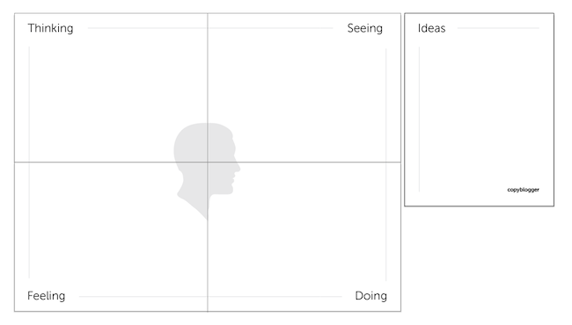
Empathy Map
Notes:
Slide 9: Using your Handout as a guide, you will fill in your blank Empathy map (or blank Miro board template). Collect information from the person you are interviewing, paying specific attention to what they say, think, do, and feel. As you add information to each quadrant, your empathy map will look something like this

Slide 10
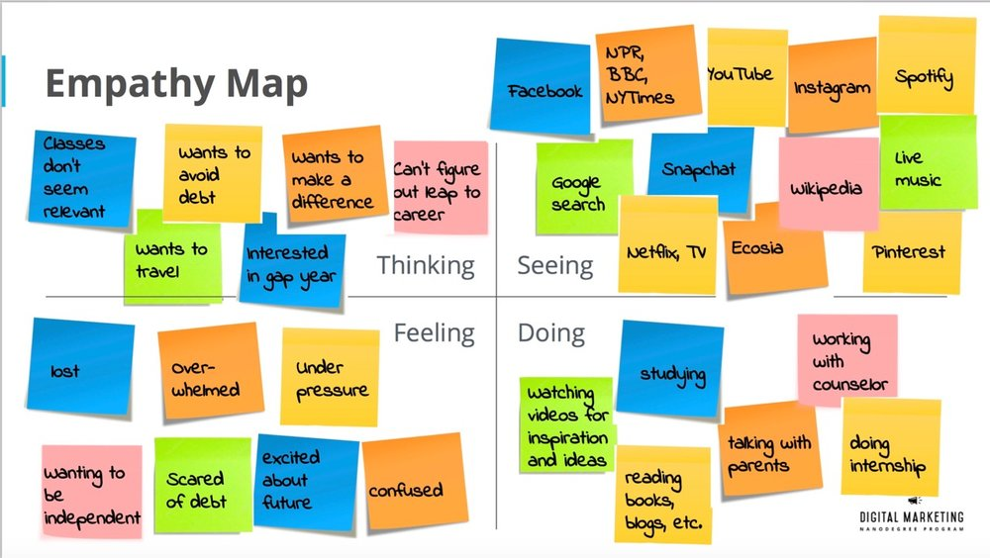

Notes:
(Slide 10) once you’ve placed the information from your interview onto your blank map.

Slide 11
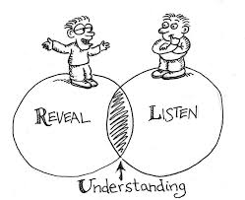

EMPATHY INTERVIEWS
Let’s try it!
  Break up into pairs
  One person describes a specific challenge you are currently facing (3 min)
  Other person asks questions, listens, and take notes on what person is thinking, seeing, feeling, and doing.
  Switch roles and repeat (3 min)
Notes:
(Slide 11) Now we’re ready to give it a try! In your pairs, decide who will begin describing a specific need or challenge with a product, system or service you use daily (3 min). While this person is talking, the listener will ask questions and take notes on what this person is thinking, seeing, feeling, and doing in order to understand a challenge, pain point, or need they face right now. After 3 minutes, switch roles with your partner and repeat the process from the opposite perspective.

Slide 12
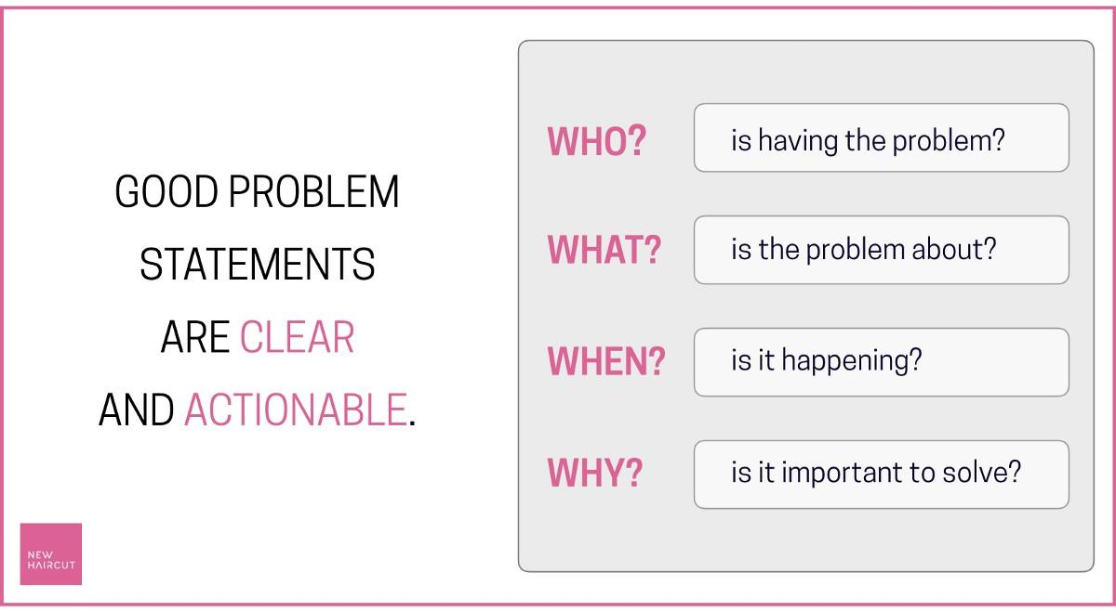
Define the Problem
Notes:
(Slide 12) Reframe a single problem: Now, pairs will come together to form groups of 4 (one group of 5 if there is an odd number). As a group, you must first select the problem from your group you want to design for. In order to have a productive brainstorming session, you will need to make sure you framed a specific need with an actionable solution moving forward. This may sound obvious, but it can be trickier than you might think. One way to save time is to go back to the verb or need that one person in your group has. You want to make sure that you don't frame the question so broadly that there's no clear starting point; it also shouldn’t be anchored on a single solution before you begin to ideate. A strong question starts with a phrase like this:

Slide 13

Write a Problem Statement
How might we help ______________________________________________
(name of person you’re helping)
find a better way to _______________________________________________
(actionable need person has)
because/in order to ______________________________________________?
(a surprising insight or takeaway)
Notes:
(Slide 13) How might we help (name of person interviewed)__________ find a better way to _______________(specific actionable need) because/ in order to (surprising insight)?
Well-framed questions will allow for the most creative and innovative ideas in the next stage of the design thinking process; Ideation.

Slide 14
Sample Problem Statement
How might we help Dr. Smith
find a better way to design the MRI machine as a fun experience
in order to make his young patients less frightened and more entertained during
their time in the MRI?
Notes:
(Slide 14) Here’s an Example of a Problem Statement Reframe from the example of the MRI machine for kids in our intro to design thinking:
How might we help Dr. Smith find a better way to design the MRI machine as a fun experience because/ in order to make his young patients less frightened and more entertained during this experience?

Slide 15
Write a Problem Statement
How might we help ______________________________________________
(name of person you’re helping)
find a better way to _______________________________________________
(actionable need person has)
because/in order to ______________________________________________?
(a surprising insight or takeaway)
Notes:
Now it’s your turn to create a How Might We statement with your group:
In your group of 4, choose *one* problem, need, or pain point from your empathy interviews.
Using your Empathy Map for this person, construct a How Might We Problem Statement to describe this problem.
Once your group feels good about this statement, write it down and bring it with you to our Ideation session.

Slide 16
Takeaways
Listen actively and openly
Stay flexible and empathetic
Be willing to reframe your question/change your mind
What was one important takeaway from your empathy interview?
Notes:
(Slide 16) Before we go, let’s share some takeaways from these empathy interviews: listen actively and openly, stay flexible and empathetic, be willing to reframe your question and change your mind at any point of the process. How about you? What did you learn from your empathy interview?

