Slide 1





Design Thinking
Introduction to Design Thinking
Ohio STEP (Science, Technology, and Entrepreneurship Program)
Heather Braun, Ph.D.
Notes:
(Slide 1) Welcome to Introduction to Design thinking. I’m Heather Braun. And today, I’m going to show you a problem-solving solving method designed to tackle messy problems in uncertain times. This method begins with fully understanding a problem and who it affects most directly: in this case - it’s you! While this approach may seem obvious, other problem-solving methods start with an idea, design the idea, and then pitch it to customers. Design thinking is different in that it offers a way to understand people and their problems before developing creative solutions.

Slide 2



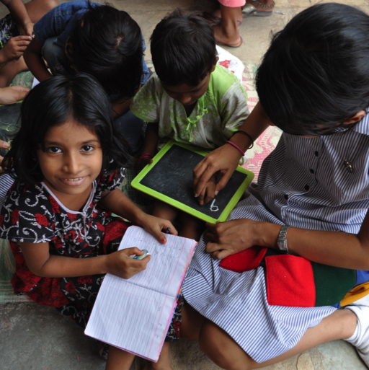
KINDS OF THINKING
WHAT IS DESIGN THINKING?
ENGINEERING THINKING
BUSINESS THINKING
RESEARCH THINKING
DESIGN THINKING
Solve your
way forward
Optimize your
way forward
Analyze your
way forward
Build your
way forward
Notes:
(Slide 2) Before we go deeper into the design thinking process and try it out for ourselves, here’s a quick review of other familiar ways to tackle problems:
Engineering Thinking (Solving) is useful for what we call tame and bounded problems that have been solved in the past. If you’re building a bridge – other bridges have been built, and if you know the length of the bridge, the materials, the load it needs to carry, you can use existing equations to solve your way forward. Once the bridge is built, the problem is solved, and you could solve that same problem again in the future.
Business Thinking (Optimizing) is useful when we want to solve problems with optimal solutions. When you use business thinking, you have known objectives and criteria to find the optimal solution.
Research Thinking (Analyzing) is an approach that uses hypotheses and relevant data to analyze with the intention of understanding patterns and trends.
Design Thinking (Building) places empathy at the center of commonly adopted research methods and encourages fast-paced, high-energy data collection, synthesis and prototyping as a framework for solving human-centered, messy or “wicked” problems. This flexible, iterative process often means failing fast to succeed sooner and learning from extreme users of a product, process, or system before working to improve it.

Slide 3
What is Design Thinking?
A process and a mindset
for understanding people & their problems before developing solutions
Notes:
(Slide 3) In a sentence, design thinking is a process and a mindset for understanding people and their problems before developing solutions.

Slide 4
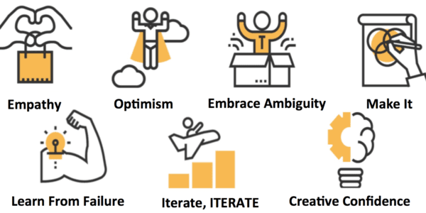
Design Thinking Mindsets
Notes:
(Slide 4) Before we try this out, it is important to consider how the following mindsets are key to the design thinking process.
Empathy, is the first step of design thinking: who is the person you’re trying to help and what is the problem they actually want to solve?
Optimism and Curiosity are important for tackling messy or wicked problems, ones that don’t have simple or single solutions.
Embracing Ambiguity means becoming more comfortable moving forward, even when you don’t know where you’re heading.
Make It. DT invites you to draw a road map, create a game plan, or design a storyboard to help explain your ideas visually as well as verbally.
Learning from Failure. This is a big one. Design thinking encourages playing with many ideas at once and not being afraid to let go of one that isn’t working.
Iterate: DT is a no-linear process - we can move easily back and forth between steps when we need more information to improve our idea.
Finally, Creative Confidence: Design thinking is built on the belief that we are all creative, even when we’re unsure about how to proceed. All of these design thinking mindsets are tools for building creative confidence

Slide 5
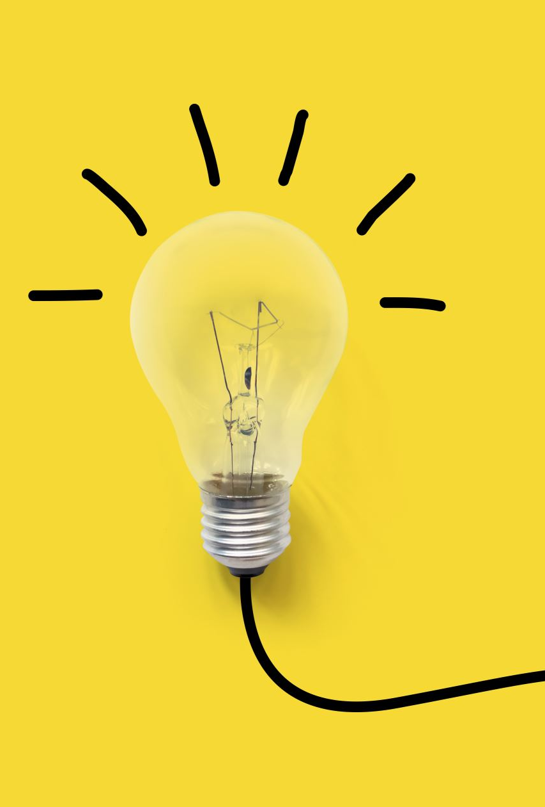

Creative Confidence
With creative confidence we become comfortable with uncertainty and are able to leap into action. Instead of resigning ourselves to the status quo, or what others have told us to do, we are freed to speak our mind[s] and challenge existing ways of doing things. We act with greater courage and have more persistence in tackling obstacles.
- Tom & David Kelley, Creative Confidence (10)
Notes:
(Slide 5) David Kelley, the founder of IDEO and Stanford’s d. School, defines creative confidence this way: “With creative confidence, we become comfortable with uncertainty and are able to leap into action. Instead of resigning ourselves to the status quo, or what others have told us to do, we are freed to speak our mind[s] and challenge existing ways of doing things. We act with greater courage and have more persistence in tackling obstacles.” Kelley, Creative Confidence (10). In other words, Creative confidence is “having the freedom and courage to fail and take creative risks and the knowledge that all of the ideas you create have value.”

Slide 6
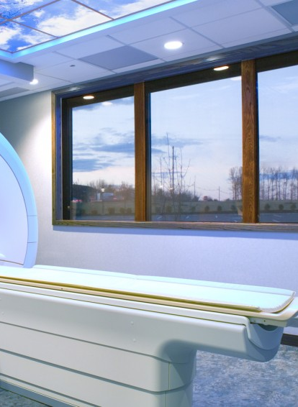
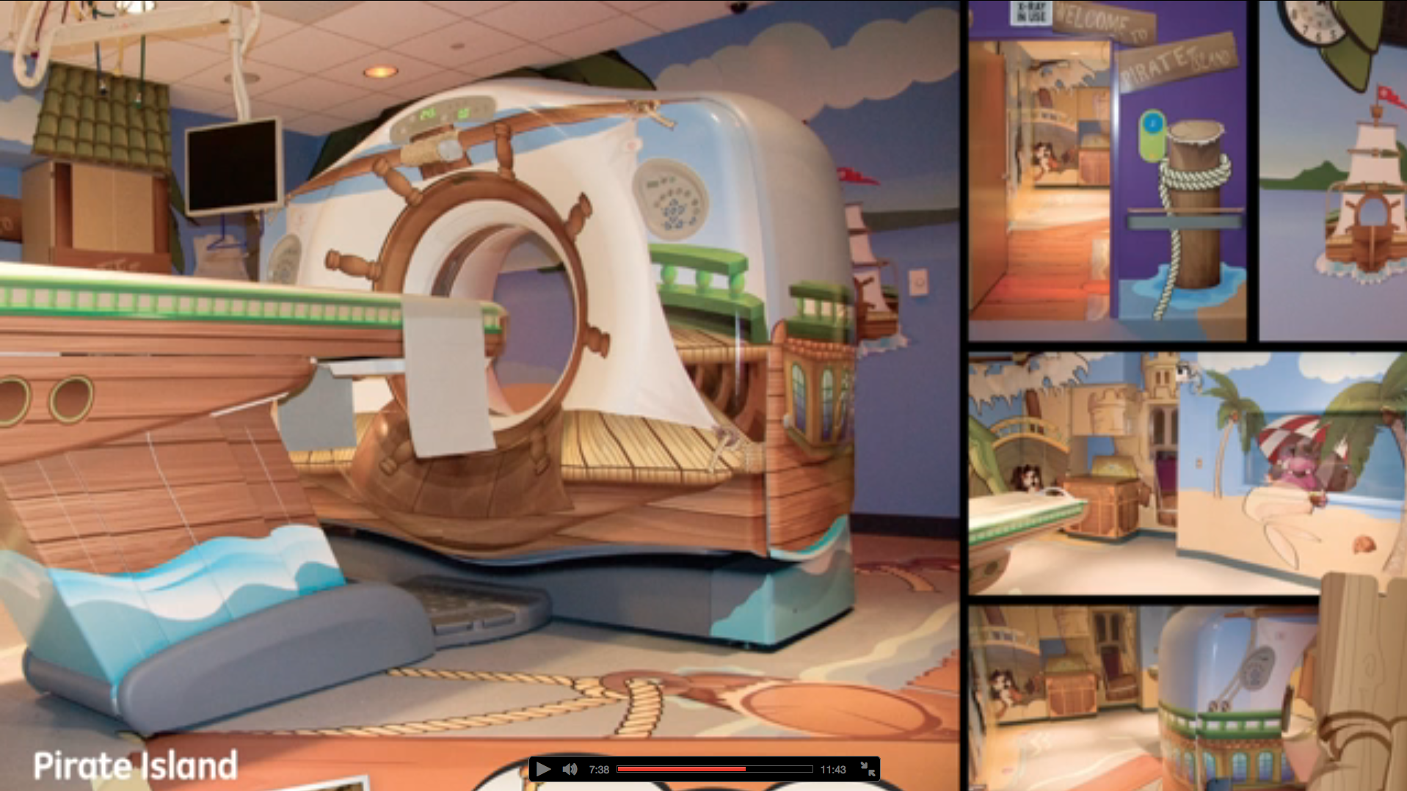
From Design Thinking to Creative Confidence
Notes:
(Slide 6) When asked about the favorite project of his entire career, David Kelley responded, “The next one.” Part of creative confidence is embracing uncertainty and learning from our mistakes. In his TED talk, Kelley gives the example of a doctor who noticed that his young patients were frightened by the experience of having an MRI. After speaking directly with these patients, this doctor redesigned the MRI machine to look like a pirate ship adventure in an effort to make his patient’s experience more comfortable and fun. One little girl asked her mother after trying out this pirate ship MRI, “Can we come back tomorrow?”

Slide 7
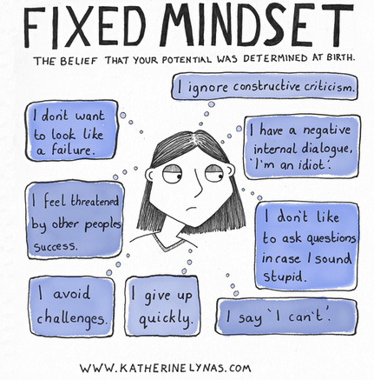
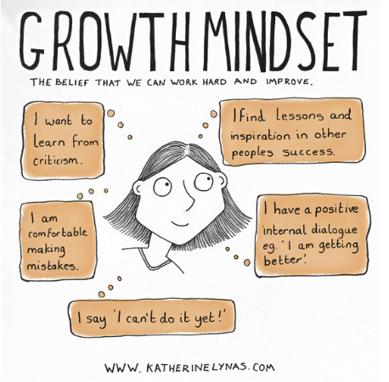
Notes:
(Slide 7) Building creative confidence means embracing a growth mindset instead of a fixed mindset: a growth mindset embraces uncertainty as a challenge and sees failure as an opportunity to learn. Unlike a fixed mindset, which sees mistakes as a reason to give up, a growth mindset helps us become more optimistic and confident about our ability to solve problems over time rather than all at once.

Slide 8
One-Word Story
In your triads, assign each person a number (1,2,3)
Following this order, tell a story together using one word at a time until you come to an appropriate stopping point.
Notes:
Let’s try out some of these design thinking mindsets with a short, painless exercise called the One Word Story
Create Groups or Breakout Rooms of 3-4 students
Assign each group member one number (1,2,3)
Then, going as quickly as you can in this order telling a story one work at a time: each person adds one word to the story until you arrive at an appropriate stopping point. If the story sounds ridiculous, keep going until you reach a stopping point and then congratulate yourselves. Have fun!

Slide 9

Let’s Share!
Notes:
(Slide 9) Share Out: Now that we’re back, tell me what it was like telling a story one word at a time. Did your story make sense? What was difficult/ fun/surprising?

Slide 10
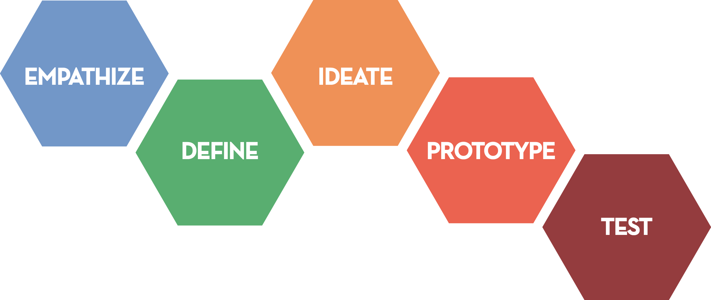
DESIGN THINKING
The process
Notes:
(Slide 10) We’ve warmed up using some design thinking mindsets - you all just embraced ambiguity by going with it and hopefully let go of the fear you’d make a mistake. Now, we’re going to look at the process of design thinking. The five basic steps in this hexagon show this process as iterative rather than linear: you may begin in about the same place, but you often return to earlier steps throughout the process.
The design process is grounded in empathy, which means the ability to share and feel with another person. You want to immerse yourself as much as possible in their lives and understand more fully their emotions and needs. In the case of product design, you are empathizing with the user and trying to understand their challenge and what they need to solve it.
Next, you’ll look at the problem from a user-centered POV. Defining the problem is essential to solving the right problem. This stage is all about determining the shape and size and characteristics of the problem you want to solve.
Once we know what problem we actually need to solve, we can begin to ideate broadly and wildly, stopping ourselves when we’re tempted to judge or second- guess our ideas. In this stage, we’ll go for volume, which makes it easier to choose our best ideas.
Once your group has selected an idea you’re excited about, you’ll need to make a simple prototype of it to share with your user. In product design, this means building our way forward, failing fast to learn and iterate and get the data we need for the next prototype or iteration.
Finally, you’ll need to test your prototype to make sure it works In product design, this means taking the prototype to the user, having them use the product and then give you feedback about their experience. Now that they have something to react to, they can envision how they will use it. With this information, you can continue making your product better.

Slide 11
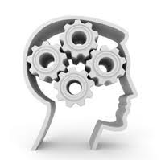
ZOOMING OUT…
An End-to-End Design Thinking Experience!
Notes:
(Slide 11) Now it’s time to zoom out to examine these steps in action. This short video from IDEO shows all five steps of the d. Thinking process in improving the design of a basic cart.

Slide 12


THE “DEEP DIVE”
IDEO demonstrates the entire design thinking process by re-imagining the shopping cart.
Notes:
(Slide 12) As you watch this video, write down the individual steps of the design thinking process you see from the hexagram I just showed you: empathy, define, ideate, build, and test.

Slide 13
IDEO Video
Watch the video ABC Nightline - IDEO Shopping Cart https://www.youtube.com/watch?v=M66ZU2PCIcM
Notes:
(Slide 12) As you watch this video, write down the individual steps of the design thinking process you see from the hexagram I just showed you: empathy, define, ideate, build, and test.

Slide 14
DESIGN THINKING
Was it all there?
Notes:
(Slide 14) Now, which steps of the design thinking process did you identify while watching this video?
Can you see ways in which you might apply these steps to solve a problem that affects you?

Slide 15



Closing Activity
EACH PERSON FILLS IN THE BLANKS:
BEFORE THIS WORKSHOP, I THOUGHT _________________
NOW, I THINK/UNDERSTAND
_____________________
Notes:
(Slide 14) This activity is for the full class. If time is limited, ask for volunteers to fill in the blanks for this sentence:
Before this workshop, I thought __________. Now I think ______________.

